Slide 1

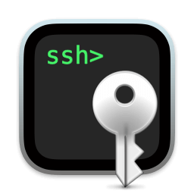
SSH
What is SSH?
How to use SSH?
Why does it exist?
SSH Keys
What are SSH keys?
How can SSH keys become a problem?
Why are SSH keys a vulnerability?

Slide 3
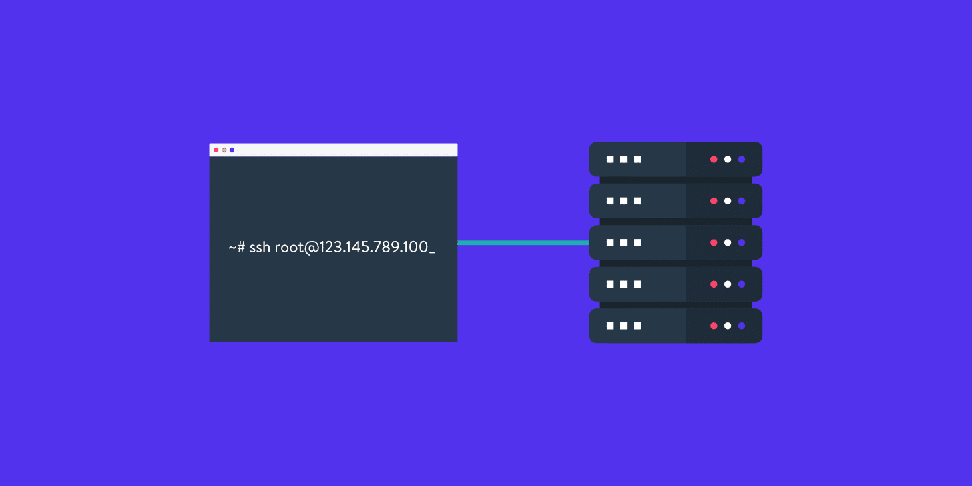
What is SSH ?
The Secure Shell Protocol (SSH) is a cryptographic network protocol for securely operating network services over an unsecured network.
Its most notable applications are remote login and command-line execution.
Every major corporation uses it, in every data center.
Source: https://en.wikipedia.org/wiki/Secure_Shell

Slide 4
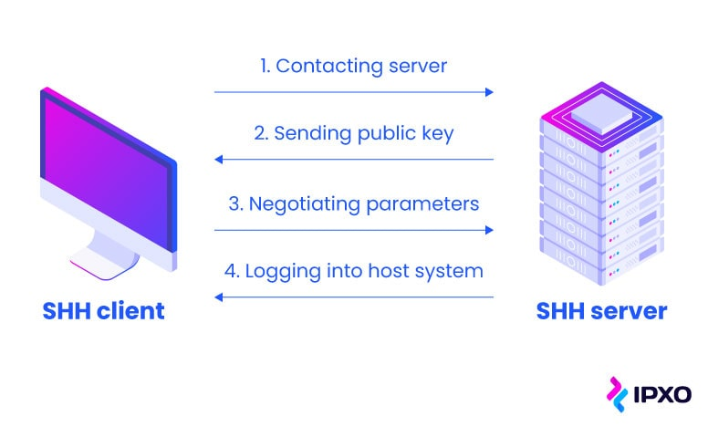
How to use SSH?
The SSH protocol uses encryption to secure the connection between a client and a server.
All user authentication, commands, output, and file transfers are encrypted to protect against attacks in the network.
Source: https://www.ssh.com/academy/ssh

Slide 5

Why does it exist?
The Secure Shell protocol was originally developed by a researcher at Helsinki University of Technology, Finland, in 1995 in response to a hacking incident in the university network.
A password sniffer had been installed on one of the servers.
When it was discovered, it had thousands of usernames and passwords in its database.
That incident triggered Tatu Ylonen to study cryptography and develop a solution for remote login over the Internet safely.
Source: https://www.ssh.com/academy/ssh

Slide 7
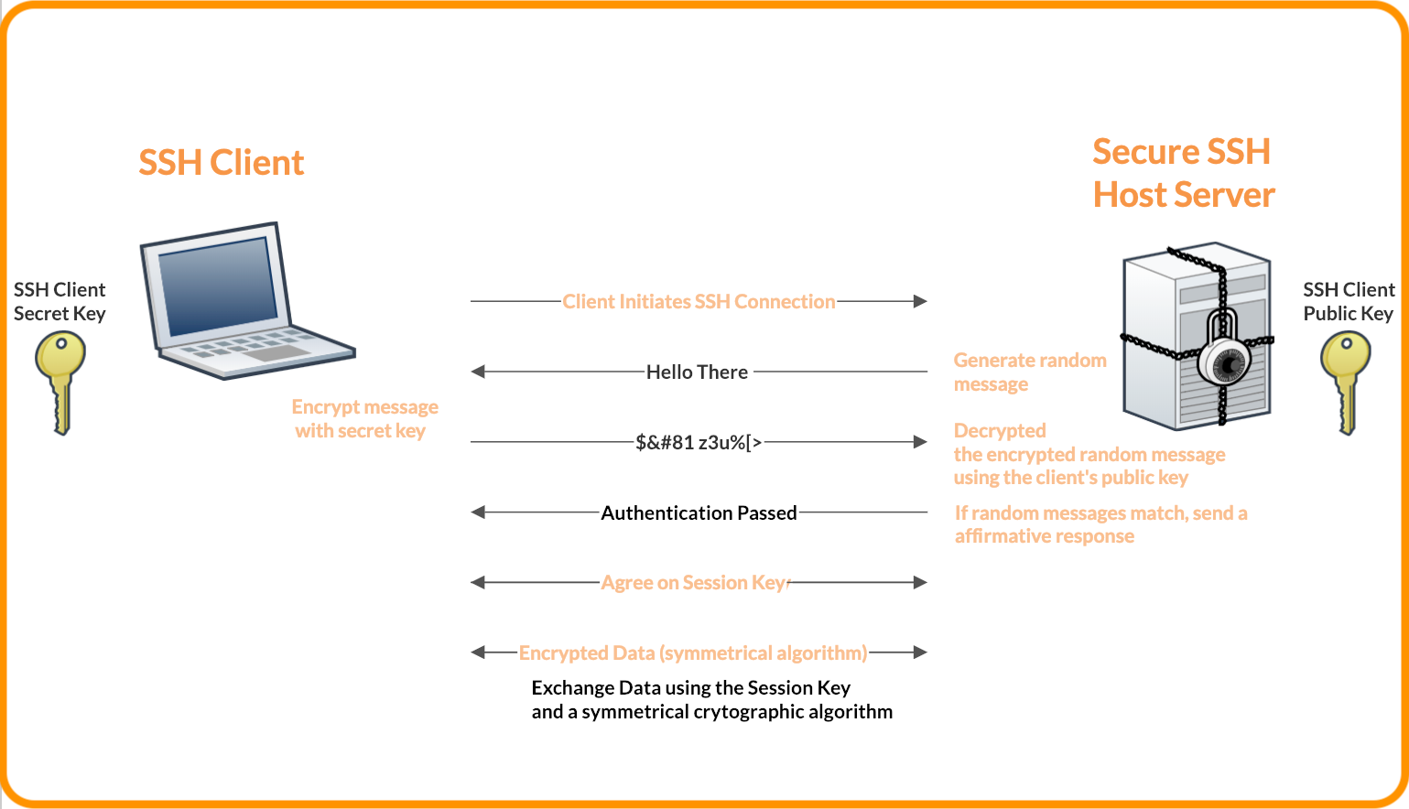
What are SSH keys?
SSH keys are authentication credentials.
Functionally SSH keys resemble passwords.
They grant access and control who can access what.
Source: https://www.ssh.com/academy/ssh

Slide 8
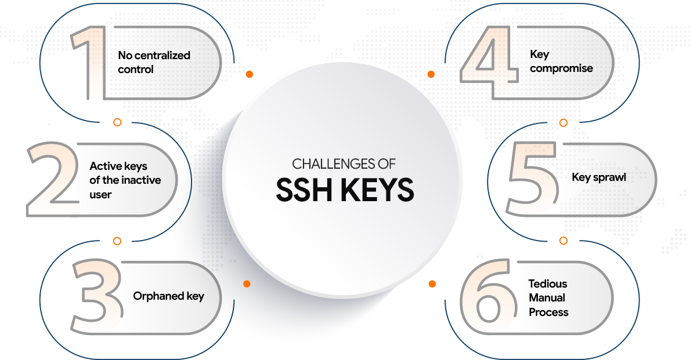
How can SSH keys become a problem?
SSH keys are used by the client and server to exchange private information in public.
So you can imagine that unmanaged access exposes organizations to significant risks that could bring down critical systems for months.
Unmanaged keys risk systemic failure of critical infrastructure, especially in a cyberwarefare scenarios.
Source: https://www.ssh.com/academy/ssh

Slide 9
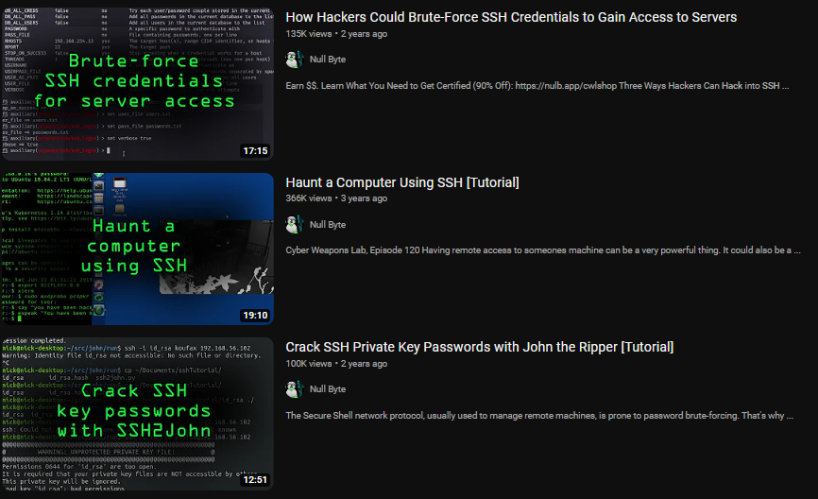
Why are SSH keys a vulnerability?
There are far more SSH keys in circulation than anyone seems to believe.
It’s not that uncommon to encounter around 3 million keys from around 15,000 servers or even 4.5 million authorized keys from 100,000 servers.
With so many unmanaged keys the likelihood of keys being misused, stolen, or used as part of an attack is high.
Remember: one single key can be enough to gain undetected access to critical systems and data.
Source: https://www.ssh.com/academy/ssh

